Slide 1
The Oregon Health Insurance Experiment: Evidence from the First Year
Amy Finkelstein, MIT and NBER
Sarah Taubman, NBER
Bill Wright, CORE
Jonathan Gruber, MIT and NBER
Mira Bernstein, NBER
Joseph Newhouse, Harvard and NBER
Heidi Allen, Columbia University
Katherine Baicker, Harvard and NBER
And the Oregon Health Study Group
Notes:
Collaborative effort between Harvard, MIT, NBER, CORE, state of Oregon, and with the help of expert consultants.

Slide 2

The Question – To Expand or Not to Expand?
What are the costs and benefits of expanding access to public health insurance for low income adults?
Costs - Health care access & utilization
Benefits – Financial
Benefits - Health
According to the Kaiser Family Foundation, Georgia has over a million uninsured adults below 138% of Federal Poverty Level
Notes:
Impact of Medicaid may be attenuated (or potentially non-existent) if public health clinics and uncompensated care allow low-income individuals to consume de facto free medical care similar to the insured. It would also be attenuated if – as if often claimed – Medicaid itself is not particular “good” insurance.

Slide 3
Why Another Study?
What can OHIE tell us that other insurance studies haven’t?
Existing evidence is more limited than you’d think
  Does Medicaid really make people sicker?
“Gold standard” research in health policy is very difficult
Notes:
IOM review of evidence – suggestive, but much uncertainty.

Slide 4
In 2008, Oregon Held a Health Insurance Lottery
  Oregon Health Plan Standard
Oregon’s Medicaid expansion program for poor adults
  - Comprehensive coverage, minimal cost-sharing
Opened waiting list for 10,000 new slots in 2008
Randomly selected names for access to coverage
  Study Design
Evaluate the effects of public insurance using lottery as RCT
Massive data collection effort
Answers specific to context, but some broader lessons

Slide 5
Overview of Approach
Experimental Design. Evaluate the effects of public HI on utilization, health, & other outcomes using lottery as RCT.
Use an intent-to-treat (ITT) approach to account for the imperfect “take-up” into coverage. This means we compare based on selection, not insured vs uninsured.
Compare outcomes between selected and non-selected individuals over time.
Extrapolate the actual effect of insurance coverage (similar to treatment on the treated, or ToT) from the ITT model to estimate the total effects of gaining insurance.
Notes:
Analysis relies on random assignment and is therefore not subject to selection bias. We pre-specified our analytic plan based on control-only data and we adjusted all of our models for multiple inference.

Slide 6
Expected Change in 1 Year
This analysis used MAIL SURVEY & ADMINISTRATIVE DATA to assess one-year findings within several domains:
Access & Use of Care
  Is access to care improved? Do the insured use more care? Is there a shift in the types of care being used?
Financial Strain
  How much does insurance protect against financial strain? What are the financial implications?
Health
  What are the short-term impacts on physical & mental health?
Notes:
Primary and secondary sources of data – focused on outcomes that we can measure in the first year.

Slide 7
Closer Look: Mail Survey Data
Fielding Protocol
  ~70,000 people, surveyed at baseline & 12 months later
  Basic protocol: Three-stage mail survey protocol, English/Spanish
  Intensive protocol on a 30% subsample included additional tracking, mailings, phone attempts
    - Done to adjust for non-response bias
Response Rate
  Weighted response rate=50%
  Non-response bias always possible, but response rate and pre-randomization measures were balanced between treatment & control
Notes:
Subject to non-response bias and self-report bias

Slide 8
Closer Look: Administrative Data
Medicaid records
  Pre-randomization demographics from list
  Enrollment records to assess “first stage” (how many of the selected got insurance coverage)
Hospital Discharge Data
  Probabilistically matched to list, de-identified at OHPR
  Includes dates and source of admissions, diagnoses, procedures, length of stay, hospital identifier
  Includes years before and after randomization
Other Data
  Mortality data from Oregon death records
  Credit report data, probabilistically matched and de-identified for analysis
Notes:
Not subject to self-report or non-response bias

Slide 9
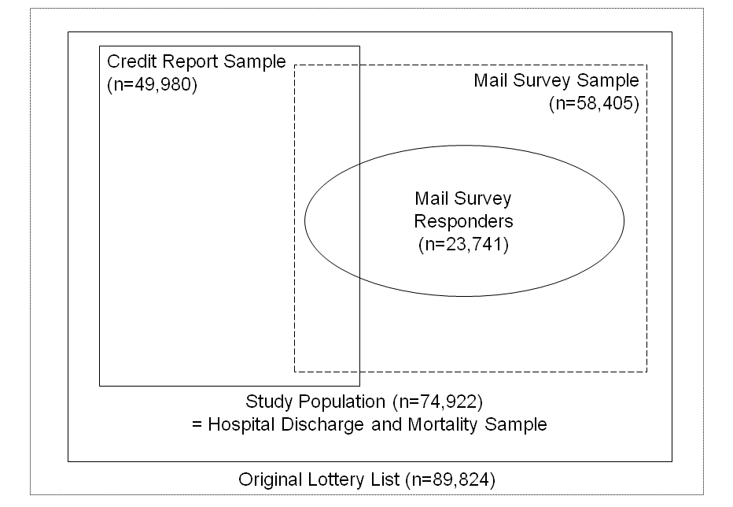
Study Population

Slide 10
Results
  The paper details one-year findings in three domains, drawing from a combination of different data sources:
Health and Use of Care
  Hospital discharge data
  Mail surveys
Financial Strain
  Credit reports
  Mail surveys
Health
  Mortality from vital statistics
  Mail surveys
  Not reflected here (coming soon):
  Biomarker Data
  Qualitative Data
  ED Administrative Data

Slide 11
Access & Use of Care
Overall, utilization and costs went up. Relative to controls….
30% increased probability of an inpatient admission
35% increased probability of an outpatient visit
15% increased probability of taking prescription medications
No change in ED usage
Total $777 increase in average spending (a 25% increase)
35% more likely to get all needed care
25% more likely to get all needed medications
Increased use of preventative services
In return for this spending, those who gained insurance were….
Notes:
$3,156 control mean spending
Gaining insurance led to better access to care and higher satisfaction with care for those who got it. It also led to increased adherence to recommended preventative care. It also increased the probability of a hospital admission, primarily driven by non-ED admissions, primarily heart-disease related.

Slide 12
A Closer Look at Prevention and Quality
Adherence to recommended preventative care:
  Cholesterol checked: 63% vs. 74%
  Ever had a diabetes test: 60% vs. 69%
  Mammogram in last 12 months: 30% vs. 49%
  PAP test in last 12 months: 41% vs. 59%
Quality measures:
  Usual place of care: 50% vs. 84%
  Have a personal provider: 49% vs. 77%
  Satisfied with quality of care: 71% vs. 85%

Slide 13
Financial Strain
Overall, reductions in collections on credit reports were evident
25% decreased probability of a medical collection
Those with a collection owed significantly less
No decrease in bankruptcy
Owing $$ for medical expense: 60% vs. 42%
Borrowing $$ or skipping other bills: 36% vs. 21%
Any out of pocket medical expenses: 56% vs. 36%
Household financial strain related to medical costs was mitigated.
Notes:
No decrease in medical-related bankruptcy, which we wouldn’t expect anyway. Important implications for patients and providers

Slide 14
Health
Overall, big improvements in self-reported physical, mental health
25% increased probability of good, v. good, excellent health
10% decrease in probability of screening for depression
Improvements here are consistent with findings of increased
utilization, better access, and improved quality
BUT in our “baseline” surveys, we saw results appearing
shortly after coverage (~2/3rds magnitude of the full results).
This may suggest increase is in perceptions of well being.
Physical health measures are open to several interpretations

Slide 15
Peace of Mind
“I have an incredible amount of fear because I don’t know if the cancer has spread or not.”
“A lot of times I wanted to rob a bank so I could pay for the meds I was just so scared… People with cancer either have a good chance or no chance. In my case it's hard to recover from lung cancer but it's possible. Insurance took so long to kick in that I didn't think I would get it. Now there is a big bright light shining on me.”

Slide 16
Future Measures
Biomarker/in-person health data
Blood pressure, cholesterol, & C-reactive protein
HbA1c levels (blood sugar control)
Body mass index scores
Longer, more sensitive depression screen
Pain scale assessments
Detailed health & health behavior data (diet, smoking, etc)
Mechanisms for positive or null findings
Qualitative interview data
ED data
Administrative data

Slide 17
Discussion
One year after expanded access to insurance, we find that Medicaid really made a difference.
Increases in hospital, outpatient, and Rx use
Improvements in measures of quality and access
Increased use of preventative screenings
Reductions in financial strain, medical collections
Significant improvement in physical and mental health
It didn’t “pay for itself” (by immediately reducing ED visits, for example), but the benefits were considerable.

Slide 18

Did We Learn Anything New?
Compared to other national surveys, and non-experimental variation in our sample, we found smaller increases in health care use and bigger effects on health.
Consistent with the theory of adverse selection
Notes:
This means that previous estimates have underestimated the cost-effectiveness of health insurance.

Slide 19
Broader Policy Lessons
No evidence of private insurance “crowd-out”
Our population is very similar to the target PPACA Medicaid expansion population
  Caveats
    Oregon’s system wasn’t likely strained by the expansion
    Mandate may reach a different population
    Oregon’s population isn’t fully representative
    Longer-run effects may differ
Notes:
Mandate may reach a different population – but we can assume imperfect take-up because it doesn’t reach this population.

Slide 20
Acknowledgements
PARTNERS
Providence: CORE
NBER/Harvard/MIT
OHPR/Oregon Health Authority
OHREC
Portland State University
OHS RECEIVED SUPPORT FROM:
Robert Wood Johnson Foundation
Sloan Foundation
California Health Care Foundation
MacArthur Foundation
Smith-Richardson Foundation
National Institutes of Health (NIH)
Centers for Medicare & Medicaid Services (CMS)
HHS Assistant Secretary for Planning & Evaluation (ASPE)
www.oregonhealthstudy.org

Slide 21
Extra Slides

Slide 22
Types of Data
Phase 1 (Mail Surveys)
  70,000 people statewide, baseline & 12 months later
Phase 2 (Biomarker & Health Interview Data)
  13,200 people within 30 miles of Portland
  Conducted 1-2 years after randomization
Phase 3 (Administrative Data)
  Medicaid enrollment records
  Statewide Hospital discharge data, 2007-2010
  Mortality & credit report data, 2007-2010
  Metro ED data from 13 hospitals 2007 - 2010
Phase 4 (Qualitative Data)
  Over 750 in-depth personal interviews

Slide 23
Sample
89,824 unique individuals on the list
Sample exclusions (based on pre-randomization data ONLY)
  --Ineligible for OHP Standard (out of state address, age, etc)
  --Individuals with institutional addresses on list
Could have improved power by bounding sample with other
data (i.e., income), but would have corrupted randomization
Final sample: 74,922 individuals (66,385 households)
  --29,834 treated individuals (surveyed 29,589)
  --45,088 control individuals (surveyed 28,816)

Slide 24
Sample Characteristics

Slide 25
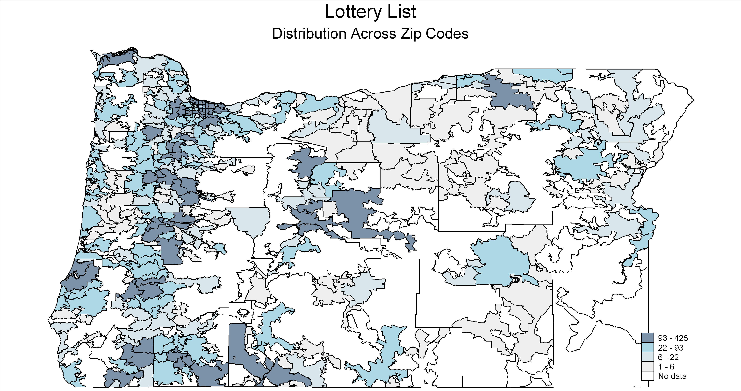
Study Population

Slide 26
Empirical Framework
We pre-specified and published our analytic plan prior to analyzing the data. We produced two types of equations
(more detail available in the full paper):
Reduced Form – effect of lottery selection
  Also known as Intent to Treat (ITT) --the difference between groups, preserving integrity of randomization.
Instrumental Variable (IV) – effect of insurance coverage
  Also known as Treatment on Treated (ToT) -- what the treatment effect would have been had everyone in the treatment group gained coverage.

Slide 27
Assumptions
  This approach does rely on some assumptions, which we test in more detail in the full paper:
  Reduced form – Intent to Treat
    Was the lottery truly random?
    Did people who won or lost the lottery differentially respond to surveys?
  IV – Treatment on Treated
    The lottery had no effect except via its impact on insurance coverage
      Winning or losing effects?
      Increased participation in other programs?
Notes:
Increase in annual food stamp income of about $45 (<.5% of annual income)
1) We are using simultaneous equation modeling – by using variables that appear in one equation to shift this equation and trace out the other.
2) The LATE theorem says that an instrument which is as good as randomly assigned, affects the outcome through a single known channel, has a first-stage, and affects the causal channel of interest only in one direction, can be used to estimate the average causal effect on the affected group (Imbens & Angrist, 1994).
3) Another way of saying this is that we know that the lottery itself has no other influence on our outcomes of interest OTHER than through the mechanism of insurance (this is called the exclusion restriction & why we looked into SNAP). We also know very few people had access to insurance except through the mechanism of the lottery (this is the presumption of independence of the instrument and the outcomes), we have identified a first stage (more people in the tx group – lottery winners – have insurance than in the control), and we are confident in the monotonicity assumption that while winning the lottery may have no effect on some people, all those who are affected are affected in essentially the same way – meaning we wouldn’t expect winning the lottery to be less likely to be insured. THEN the Wald estimate can be interpreted as the effect of insurance on those who won the lottery. This parameter is called the local average treatment effect or LATE.
To put it simply: Differences between tx and control are only attributable to the lottery (this tells us the ‘winning’ effect. There is a 25% difference in insurance between treatment and control that is only attributable to the lottery (reflecting imperfect take-up). Unless there is something else about winning that would lead to outcomes, to understand of insurance – you simply multiple the ITT estimate by .25%

Slide 28
Empirical Framework: Reduced Form
LOTTERY indicator for whether household h selected
X denotes covariates correlated with treatment probability
  Household size indicators
  In survey data: Survey wave (and interactions with HH size)
V denotes (optional) covariates
  Survey data: none
  Admin data: lottery draw; pre-randomization y

Slide 29
Empirical Framework: IV Estimation
Two-stage Least Squares (2SLS):
With the first stage equation:
Similar multiple inference adjustment
Notes:
We interpret the coefficient on insurance from instrumental variable estimation of the 2SLS as the local average tx effect of insurance. Our estimate identifies the casual impact of insurance among the subset of individuals who obtain insurance on winning the lottery and who would not obtain insurance without winning the lottery. The LATE estimate is given by the ratio of the ITT coefficient and the first stage coefficient on lottery.

Slide 30
Effects of Lottery on Coverage (1st Stage)

Slide 31
Inference Over Multiple Outcomes
Group outcomes into “domains” (e.g. health, financial strain)
Summary measure: average standardized treatment effect across all outcomes j in domain J:
Individual estimates (β_{1j}’s)
  Per-comparison (usual) p-values
  “Family-wise” p-values (Westfall-Young)

Slide 32
Results: Access & Use of Care
Gaining insurance resulted in increased probability of hospital admissions, primarily driven by non-ED admissions.
 | CONTROL | RF Model (ITT) | IV Model (ToT) | P-Value
Any hospital admission | 6.7% | +.50% | +2.1% | .004
--Admits through ED | 4.8% | +.2% | +.7% | .265
--Admits NOT through ED | 2.9% | +.4% | +1.6% | .002
SOURCE: Hospital Discharge Data.
Overall, this represents a 30% higher probability of admission, although admissions are still rare events.

Slide 33
Results: Access & Use of Care
Gaining insurance resulted in better access to care and higher satisfaction with care (conditional on actually getting care).
 | CONTROL | RF Model (ITT) | IV Model (ToT) | P-Value
Have a usual place of care | 49.9% | +9.9% | +33.9% | .0001
Have a personal doctor | 49.0% | +8.1% | +28.0% | .0001
Got all needed health care | 68.4% | +6.9% | +23.9% | .0001
Got all needed prescriptions | 76.5% | +5.6% | +19.5% | .0001
Satisfied with quality of care | 70.8% | +4.3% | +14.2% | .001
SOURCE: Survey data.
Notes:
Satisfied with care was conditional on getting any

Slide 34
Results: Access & Use of Care
Gaining insurance resulted in increased adherence to recommended preventive care.
 | CONTROL | RF Model (ITT) | IV Model (ToT) | P-Value*
Ever had cholesterol checked | 62.5% | +3.3% | +11.4% | .0001
Ever had diabetes test | 60.4% | +2.6% | +9.0% | .0001
Mammogram in last 12 mos | 29.8% | +5.5% | +18.7% | .0001
PAP test in last 12 mos | 40.6% | +5.1% | +18.3% | .0001
SOURCE: Survey data.
*NOTE: All p-values take into account that we estimated multiple equations within each domain of interest.

Slide 35
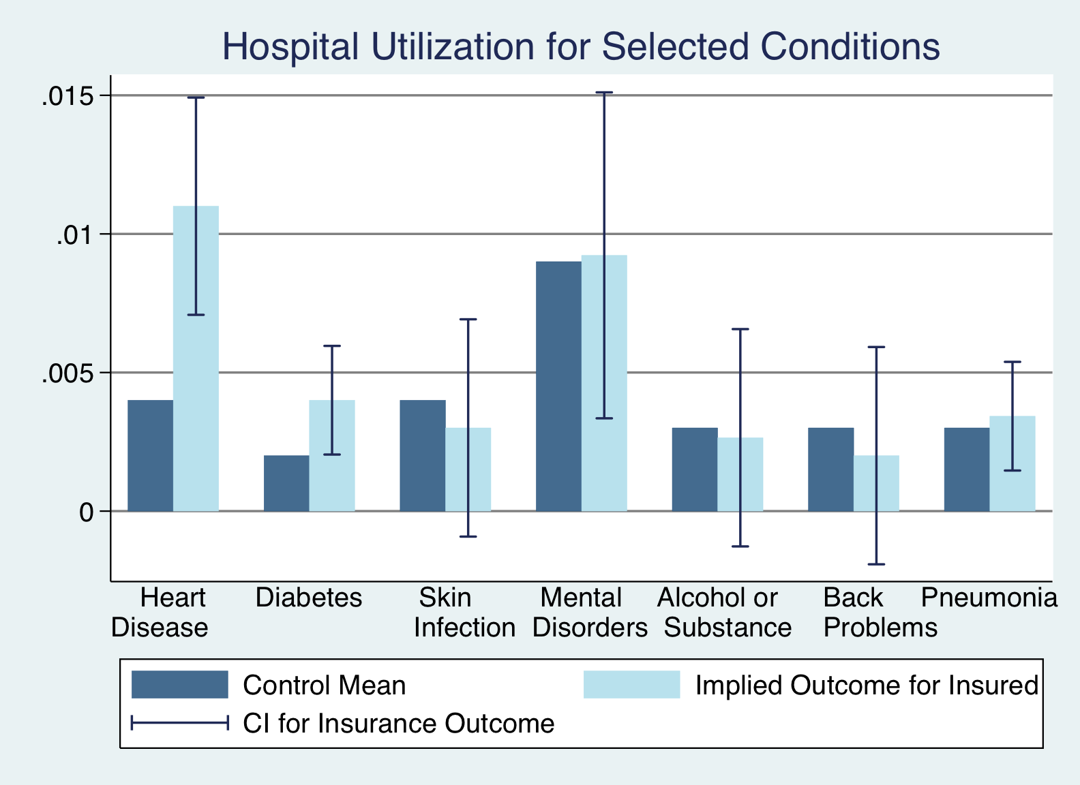
Total Use By Condition

Slide 36
Results: Financial Strain
Gaining insurance resulted in a reduced probability of having medical collections in credit reports, and in lower amounts owed.
 | CONTROL | RF Model (ITT) | IV Model (ToT) | P-Value
Had a bankruptcy | 1.4% | +0.2% | +0.9% | .358
Had a collection | 50.0% | -1.2% | -4.8% | .013
--Medical collections | 28.1% | -1.6% | -6.4% | .0001
--Non-medical collections | 39.2% | -0.5 | -1.8% | .455
$ owed medical collections | $1,999 | -$99 | -$390 | .025
SOURCE: Credit report data.
Notes:
Wouldn’t really expect a bankruptcy because of the time-lag it takes to acquire the debt, go to collections, and then process a bankruptcy.

Slide 37
Results: Financial Strain
Survey measures suggest that gaining insurance significantly mitigated household financial strain.
 | CONTROL | RF Model (ITT) | IV Model (ToT) | P-Value
Owe $ for medical expenses | 59.7% | -5.2% | -18.0% | .0001
Borrowed $ or skipped other bills to pay medical bills | 36.4% | -4.5% | -15.4% | .0001
Any out of pocket medical expenses | 55.5% | -5.8% | -20.0% | .0001
SOURCE: Survey data, six month recall period.

Slide 38
Results: Health
Self-report measures showed significant health improvements one year after randomization.
 | CONTROL | RF Model (ITT) | IV Model (ToT) | P-Value
Health good, v good, excellent | 54.8% | +3.9% | +13.3% | .0001
Health stable or improving | 71.4% | +3.3% | +11.3% | .0001
Depression screen NEGATIVE | 67.1% | +2.3% | +7.8% | .003
CDC Healthy Days (physical) | 21.86 | +.381 | +1.31 | .018
CDC Healthy Days (mental) | 18.73 | +.603 | +2.08 | .003
SOURCE: Survey data.

Slide 39
Comparison to RAND
Compare Medicaid experiment (no ins → Medicaid) to RAND (least → most generous coverage)
Increased health care use – smaller than expected?
  25% (vs 45%) increase in spending
  55% (vs. 75%) increase in number of outpatient visits
  30% (vs. 30%) increase in probability of hosp admission
Self reported health increase – bigger than expected?
  RAND: no evidence of impact of insurance generosity on adult self-reported general health or mental health.

