Slide 1
The Oregon Health Insurance Experiment: Evidence from the First Year
Amy Finkelstein, MIT and NBER
Sarah Taubman, NBER
Bill Wright, CORE
Jonathan Gruber, MIT and NBER
Mira Bernstein, NBER
Joseph Newhouse, Harvard and NBER
Heidi Allen, Columbia University
Katherine Baicker, Harvard and NBER
And the Oregon Health Study Group
Notes:
Collaborative effort between Harvard, MIT, NBER, CORE, state of Oregon, and with the help of expert consultants.

Slide 2

The Question – To Expand or Not to Expand?
What are the costs and benefits of expanding access to public health insurance for low income adults?
Costs - Health care access & utilization
Benefits – Financial
Benefits - Health
According to the Kaiser Family Foundation, Georgia has over a million uninsured adults below 138% of Federal Poverty Level
Notes:
Impact of Medicaid may be attenuated (or potentially non-existent) if public health clinics and uncompensated care allow low-income individuals to consume de facto free medical care similar to the insured. It would also be attenuated if – as if often claimed – Medicaid itself is not particular “good” insurance.

Slide 3
Why Another Study?
What can OHIE tell us that other insurance studies haven’t?
Existing evidence is more limited than you’d think
  Does Medicaid really make people sicker?
“Gold standard” research in health policy is very difficult
Notes:
IOM review of evidence – suggestive, but much uncertainty.

Slide 4
In 2008, Oregon Held a Health Insurance Lottery
  Oregon Health Plan Standard
Oregon’s Medicaid expansion program for poor adults
  - Comprehensive coverage, minimal cost-sharing
Opened waiting list for 10,000 new slots in 2008
Randomly selected names for access to coverage
  Study Design
Evaluate the effects of public insurance using lottery as RCT
Massive data collection effort
Answers specific to context, but some broader lessons

Slide 5
Overview of Approach
Experimental Design. Evaluate the effects of public HI on utilization, health, & other outcomes using lottery as RCT.
Use an intent-to-treat (ITT) approach to account for the imperfect “take-up” into coverage. This means we compare based on selection, not insured vs uninsured.
Compare outcomes between selected and non-selected individuals over time.
Extrapolate the actual effect of insurance coverage (similar to treatment on the treated, or ToT) from the ITT model to estimate the total effects of gaining insurance.
Notes:
Analysis relies on random assignment and is therefore not subject to selection bias. We pre-specified our analytic plan based on control-only data and we adjusted all of our models for multiple inference.

Slide 6
Expected Change in 1 Year
This analysis used MAIL SURVEY & ADMINISTRATIVE DATA to assess one-year findings within several domains:
Access & Use of Care
  Is access to care improved? Do the insured use more care? Is there a shift in the types of care being used?
Financial Strain
  How much does insurance protect against financial strain? What are the financial implications?
Health
  What are the short-term impacts on physical & mental health?
Notes:
Primary and secondary sources of data – focused on outcomes that we can measure in the first year.

Slide 7
Closer Look: Mail Survey Data
Fielding Protocol
  ~70,000 people, surveyed at baseline & 12 months later
  Basic protocol: Three-stage mail survey protocol, English/Spanish
  Intensive protocol on a 30% subsample included additional tracking, mailings, phone attempts
    - Done to adjust for non-response bias
Response Rate
  Weighted response rate=50%
  Non-response bias always possible, but response rate and pre-randomization measures were balanced between treatment & control
Notes:
Subject to non-response bias and self-report bias

Slide 8
Closer Look: Administrative Data
Medicaid records
  Pre-randomization demographics from list
  Enrollment records to assess “first stage” (how many of the selected got insurance coverage)
Hospital Discharge Data
  Probabilistically matched to list, de-identified at OHPR
  Includes dates and source of admissions, diagnoses, procedures, length of stay, hospital identifier
  Includes years before and after randomization
Other Data
  Mortality data from Oregon death records
  Credit report data, probabilistically matched and de-identified for analysis
Notes:
Not subject to self-report or non-response bias

Slide 9
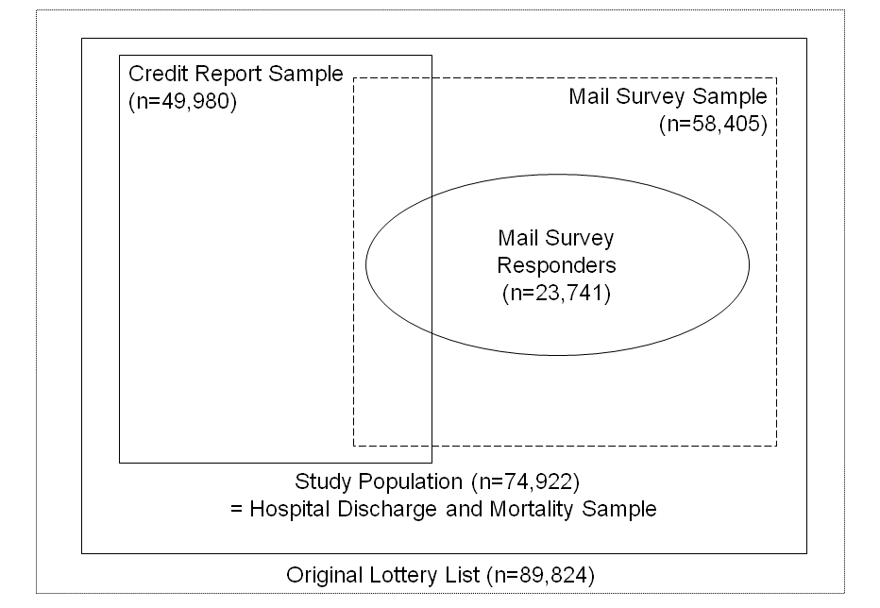
Study Population

Slide 10
Results
  The paper details one-year findings in three domains, drawing from a combination of different data sources:
Health and Use of Care
  Hospital discharge data
  Mail surveys
Financial Strain
  Credit reports
  Mail surveys
Health
  Mortality from vital statistics
  Mail surveys
  Not reflected here (coming soon):
  Biomarker Data
  Qualitative Data
  ED Administrative Data

Slide 11
Access & Use of Care
Overall, utilization and costs went up. Relative to controls….
30% increased probability of an inpatient admission
35% increased probability of an outpatient visit
15% increased probability of taking prescription medications
No change in ED usage
Total $777 increase in average spending (a 25% increase)
35% more likely to get all needed care
25% more likely to get all needed medications
Increased use of preventative services
In return for this spending, those who gained insurance were….
Notes:
$3,156 control mean spending
Gaining insurance led to better access to care and higher satisfaction with care for those who got it. It also led to increased adherence to recommended preventative care. It also increased the probability of a hospital admission, primarily driven by non-ED admissions, primarily heart-disease related.

Slide 12
A Closer Look at Prevention and Quality
Adherence to recommended preventative care:
  Cholesterol checked: 63% vs. 74%
  Ever had a diabetes test: 60% vs. 69%
  Mammogram in last 12 months: 30% vs. 49%
  PAP test in last 12 months: 41% vs. 59%
Quality measures:
  Usual place of care: 50% vs. 84%
  Have a personal provider: 49% vs. 77%
  Satisfied with quality of care: 71% vs. 85%

Slide 13
Financial Strain
Overall, reductions in collections on credit reports were evident
25% decreased probability of a medical collection
Those with a collection owed significantly less
No decrease in bankruptcy
Owing $$ for medical expense: 60% vs. 42%
Borrowing $$ or skipping other bills: 36% vs. 21%
Any out of pocket medical expenses: 56% vs. 36%
Household financial strain related to medical costs was mitigated.
Notes:
No decrease in medical-related bankruptcy, which we wouldn’t expect anyway. Important implications for patients and providers

Slide 14
Health
Overall, big improvements in self-reported physical, mental health
25% increased probability of good, v. good, excellent health
10% decrease in probability of screening for depression
Improvements here are consistent with findings of increased
utilization, better access, and improved quality
BUT in our “baseline” surveys, we saw results appearing
shortly after coverage (~2/3rds magnitude of the full results).
This may suggest increase is in perceptions of well being.
Physical health measures are open to several interpretations

Slide 15
Peace of Mind
“I have an incredible amount of fear because I don’t know if the cancer has spread or not.”
“A lot of times I wanted to rob a bank so I could pay for the meds I was just so scared… People with cancer either have a good chance or no chance. In my case it's hard to recover from lung cancer but it's possible. Insurance took so long to kick in that I didn't think I would get it. Now there is a big bright light shining on me.”

Slide 16
Future Measures
Biomarker/in-person health data
Blood pressure, cholesterol, & C-reactive protein
HbA1c levels (blood sugar control)
Body mass index scores
Longer, more sensitive depression screen
Pain scale assessments
Detailed health & health behavior data (diet, smoking, etc)
Mechanisms for positive or null findings
Qualitative interview data
ED data
Administrative data

Slide 17
Discussion
One year after expanded access to insurance, we find that Medicaid really made a difference.
Increases in hospital, outpatient, and Rx use
Improvements in measures of quality and access
Increased use of preventative screenings
Reductions in financial strain, medical collections
Significant improvement in physical and mental health
It didn’t “pay for itself” (by immediately reducing ED visits, for example), but the benefits were considerable.

Slide 18

Did We Learn Anything New?
Compared to other national surveys, and non-experimental variation in our sample, we found smaller increases in health care use and bigger effects on health.
Consistent with the theory of adverse selection
Notes:
This means that previous estimates have underestimated the cost-effectiveness of health insurance.

Slide 19
Broader Policy Lessons
No evidence of private insurance “crowd-out”
Our population is very similar to the target PPACA Medicaid expansion population
  Caveats
    Oregon’s system wasn’t likely strained by the expansion
    Mandate may reach a different population
    Oregon’s population isn’t fully representative
    Longer-run effects may differ
Notes:
Mandate may reach a different population – but we can assume imperfect take-up because it doesn’t reach this population.

Slide 20
Acknowledgements
PARTNERS
Providence: CORE
NBER/Harvard/MIT
OHPR/Oregon Health Authority
OHREC
Portland State University
OHS RECEIVED SUPPORT FROM:
Robert Wood Johnson Foundation
Sloan Foundation
California Health Care Foundation
MacArthur Foundation
Smith-Richardson Foundation
National Institutes of Health (NIH)
Centers for Medicare & Medicaid Services (CMS)
HHS Assistant Secretary for Planning & Evaluation (ASPE)
www.oregonhealthstudy.org

