Slide 1

Mortality and Access to Care Among Adults After State Medicaid Expansions
Benjamin D. Sommers, Katherine Baicker, & Arnold Epstein
Harvard School of Public Health
October, 2012

Slide 2
Background
The Affordable Care Act (ACA) expands Medicaid in 2014 to all adults up to 133% of the federal poverty level
Recent Supreme Court ruling determined that states have the option of whether to participate in expansion
Governors and legislators in several states have said they will not implement the expansion – while many others have said they are reluctant to do so.
2
Notes:
2

Slide 3
Background
Reasons given by states that they will not expand Medicaid include:
  They oppose the ACA and won’t implement any of it
  They can’t afford it – a threat of “financial ruin”
  Because it is a “broken program”
Meanwhile, several states have already expanded Medicaid to adults over the past decade
3
Notes:
3

Slide 4
Background
Reasons given by states that they will not expand Medicaid include:
  They oppose the ACA and won’t implement any of it
  They can’t afford it – a threat of “financial ruin”
  Because it is a “broken program”
Meanwhile, several states have already expanded Medicaid to adults over the past decade
Yet the health impact of Medicaid coverage is unclear, particularly for adults
4
Notes:
4

Slide 5
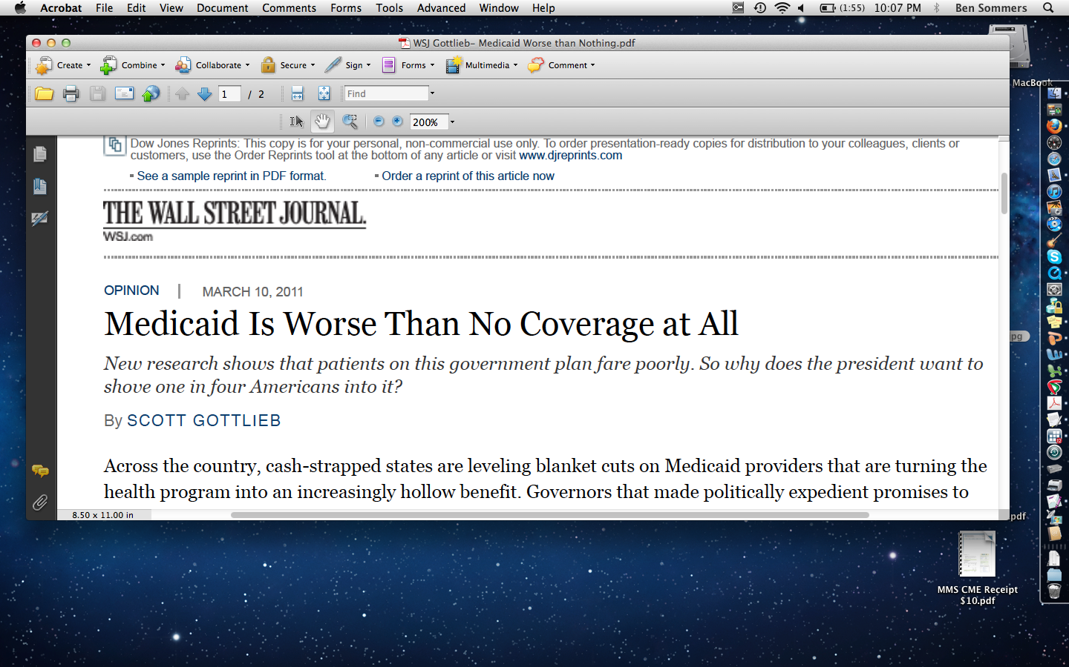
5
Notes:
5

Slide 6
Objectives
To examine whether state Medicaid expansions were associated with any changes in all-cause mortality
Secondary outcomes:
  insurance coverage
  access to care
  self-reported health
6
Notes:
6

Slide 7
Methods
We identified 3 states that expanded Medicaid to childless adults between 2000-2005: NY, Maine, Arizona
We compared them to neighboring states with similar populations and no Medicaid expansion
7
Notes:
7

Slide 8
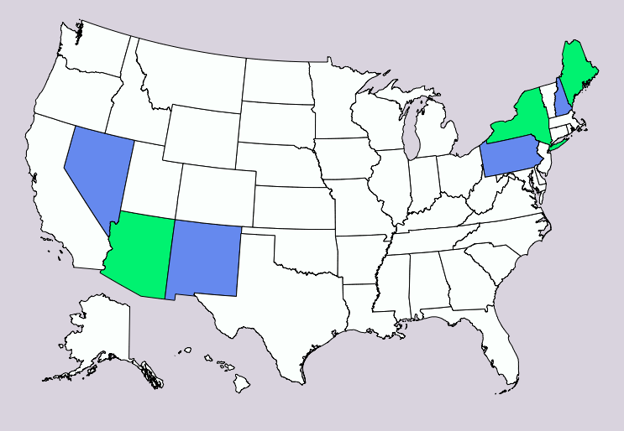
Study States
Treatment States 1) NY 2) ME 3) AZ
Control States 1) PA 2) NH 3) NM & NV
8
Notes:
8

Slide 9
Primary Outcome: Mortality
All-Cause Mortality: County-level mortality by race, age, and gender from the Centers for Disease Control & Prevention (CDC)
Time Period: 1997-2007, for 5 years before and after each expansion
Study Sample:Adults ages 20 to 64
9
Notes:
9

Slide 10
Other Outcomes
Insurance: % with Medicaid coverage, % uninsured, from Census Bureau’s Current Population Survey
Access to Care: % experiencing cost-related barriers to care, from CDC’s Behavioral Risk Factor Surveillance System
Self-Reported Health: % in excellent or very good health
10
Notes:
10

Slide 11
Methods - Briefly
Our analysis adjusted for factors includingrace, age, sex, county, and local economic conditions
Important because our analysis – unlike Oregon – is not randomized, so other differences between states could affect our results
11
Notes:
11

Slide 12
Results: Medicaid
Percent of Non-Elderly Adults Enrolled in Medicaid
Years before/after state Medicaid expansion
12
Notes:
12

Slide 13
Results: Uninsured
Percent of Non-Elderly Adults Who Are Uninsured
Years before/after state Medicaid expansion
13
Notes:
13

Slide 14
Results: Cost-Related Barriers
Percent of Non-Elderly Adults Delaying Medical Care Due to Cost
14
Notes:
14

Slide 15
Results: Self-Reported Health
Percent of Non-Elderly Adults in Excellent/Very Good Health
Years before/after state Medicaid expansion
15
Notes:
15

Slide 16
Results: Mortality
Deaths per 100,000 Non-Elderly Adults
Years before/after state Medicaid expansion
16
Notes:
16

Slide 17
Multivariate Analyses
Outcome | Post-Expansion Absolute Change (Treatment vs. Control) | Post-Expansion Relative Change (Treatment vs. Control) | P-value
Medicaid | +2.2 percentage points | +24.7% | 0.01
Uninsured | -3.2 percentage points | -14.7% | <0.001
Cost-Related Barriers to Care | -2.9 percentage points | -21.3% | 0.002
Excellent or Very Good Health | +2.2 percentage points | +3.4% | 0.04
All-Cause Mortality | -19.6 deaths per 100,000 | -6.1% | 0.001
17
Notes:
17

Slide 18
Which Groups Benefited?
The decline in the death rate was significant for both whites and non-whites, but was twice as high among non-whites
Medicaid was associated with larger health gains for older adults (35-64) and for people living in poorer areas
All of this is consistent with whom we might expect to benefit most from a Medicaid expansion
18
Notes:
18

Slide 19
Discussion
Medicaid expansions were associated with significant reductions in mortality over a five-year follow-up period
Pathway of secondary outcomes: Coverage ➔ Access ➔ Health ➔Survival
Consistent with gains in access and self-reported health in Medicaid from the randomized trial in Oregon
19
Notes:
19

Slide 20
Limitations
Results driven by largest state (New York), unclear how generalizable results may be
Lack of individual-level information (especially health and chronic diseases) in mortality data
Non-randomized design
  Results can only show an association
  Other unmeasured trends could be producing the observed results
20
Notes:
20

Slide 21
Policy Implications
Expanding Medicaid may, simply put, save lives
These state expansions are quite similar to what states are considering under the ACA, though the latter expansions would be even bigger
Would all states see the same benefits?
21
Notes:
21

Slide 22
Cost: The Missing Piece
Our data sources do not allow us to measure costs
Oregon findings and other research suggests people with insurance will use more services and cost more
22
Notes:
22

Slide 23
Cost: The Missing Piece
But Medicaid remains less expensive than most private insurance
Federal share of the ACA expansion is quite generous, and some state spending will be offset by reductions in uncompensated care
23
Notes:
23

Slide 24
Conclusions
Medicaid expansions are associated with improved coverage, access, health, and reduced mortality
Expanded Medicaid under the ACA may significantly improve health for millions of low-income adults
Cuts in Medicaid – or repealing the Medicaid expansion – likely would adversely impact the health of vulnerable populations
24
Notes:
24

Slide 25
Acknowledgments
Many thanks to my co-authors Arnie Epstein and Kate Baicker at the Harvard School of Public Health
25
Notes:
25

